Slide 1

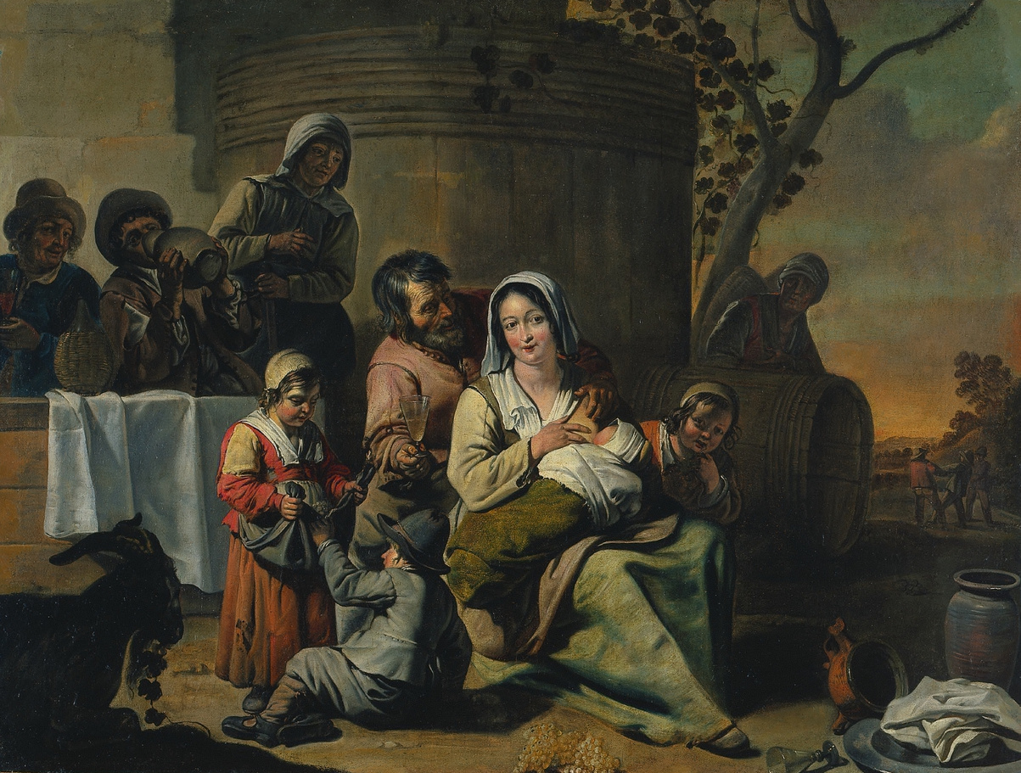
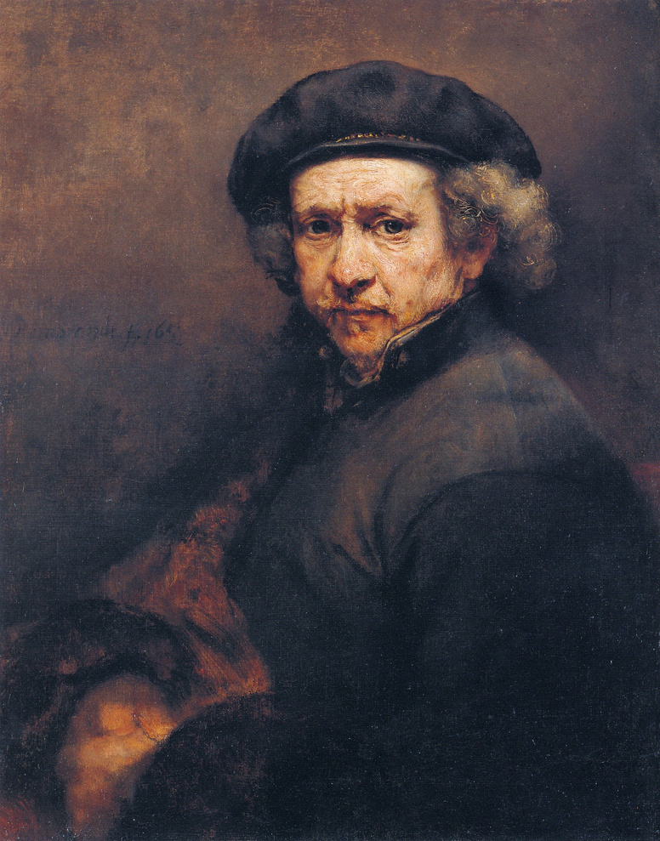
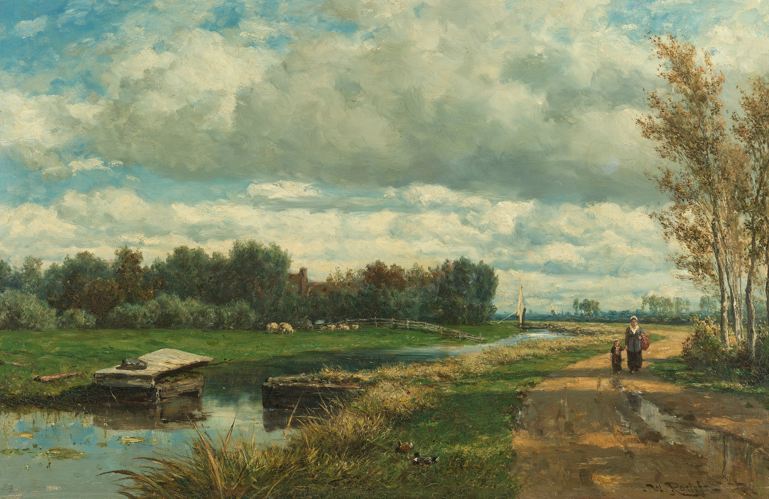

SQL PAINTINGS
CASE STUDY
Presented by: Pranavi Pulipaka
May, 2024

Slide 2
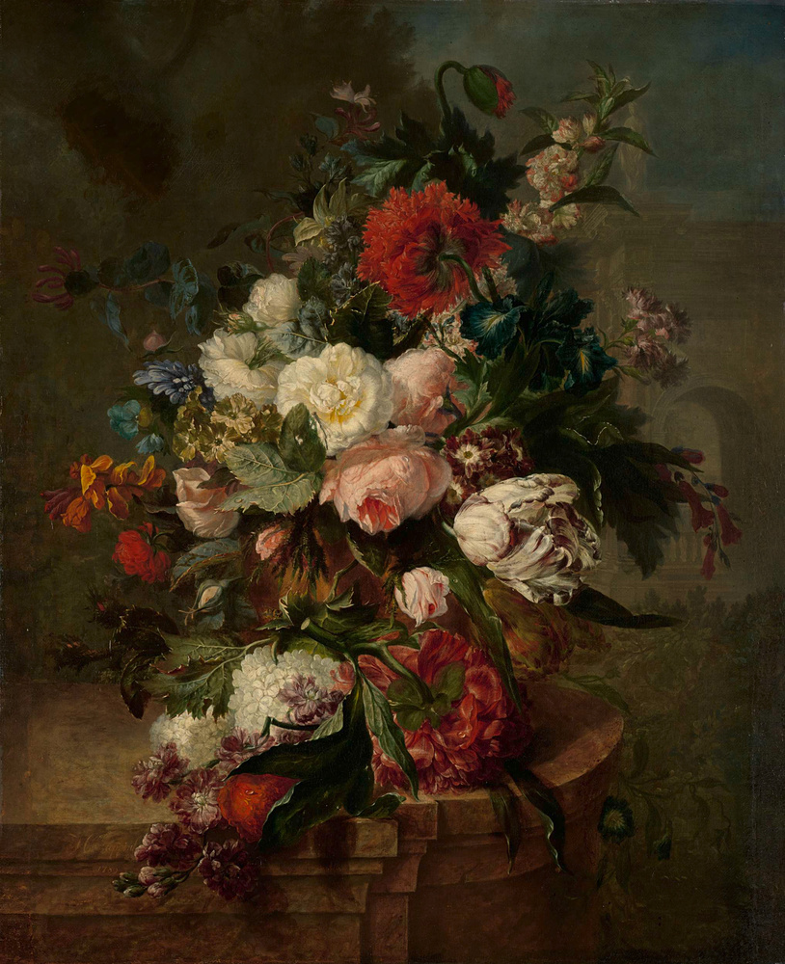

Fetch all the paintings which are not displayed on any museums?

Slide 3
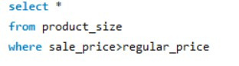
How many paintings have an asking price of more than their regular price?

Slide 4
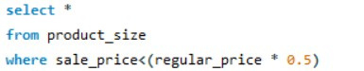
Identify the paintings whose asking price is less than 50% of its regular price?

Slide 5
Which canva size costs the most?

Slide 6

Delete duplicate records from work table

Slide 7
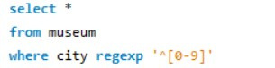
Identify the museums with invalid city information in the given dataset

Slide 8
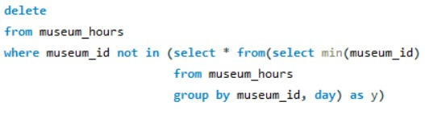
Museum_Hours table has 1 invalid entry. Identify it and remove it

Slide 9

Fetch the top 10 most famous painting subject

Slide 10

Identify the museums which are open on both Sunday and Monday. Display museum name, city.

Slide 11
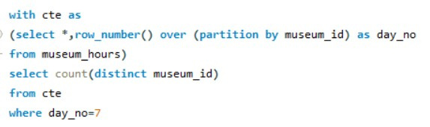
How many museums are open every single day?

Slide 12
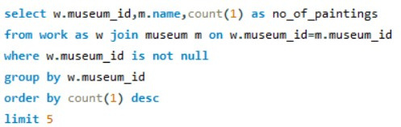
Which are the top 5 most popular museum? (Popularity is defined based on most no of paintings in a museum)

Slide 13

Display the 3 least popular canva sizes

Slide 14

Which museum is open for the longest during a day. Dispay museum name, state and hours open and which day?

Slide 15

Identify the artists whose paintings are displayed in multiple countries

Slide 16
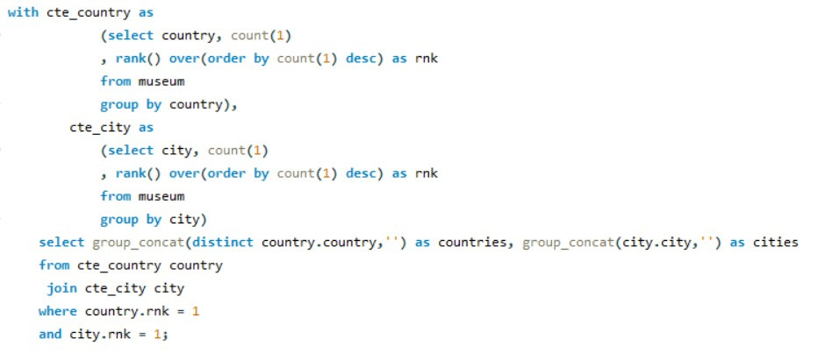
Display the country and the city with most no of museums.

Slide 17

Identify the artist and the museum where the most expensive and least expensive painting is placed.
Display the artist name, sale_price, painting name, museum name, museum city and canvas label

Slide 18

Which country has the 5th highest no of paintings?

Slide 19

Which are the 3 most popular and 3 least popular painting styles?

Slide 20
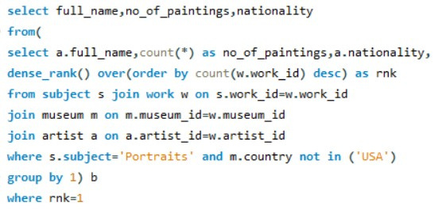
Which artist has the most no of Portraits paintings outside USA?
Display artist name, no of paintings and the artist nationality.

Slide 21
Insights
There are a total of 10104 paintings that are not displayed in any museum The most expensive canvas size is 48" x 96"(122 cm x 244 cm) The most famous painting subjects are Portraits, Nudes, Landscapes, Flowers, Abstract/Modern Art etc There are 18 museums which are open all 7 days of a week The top 5 museums are as follows: The Metropolitan Museum of Art, Rijksmuseum, National Gallery, National Gallery of Art, The Barnes Foundation The top 5 most popular artist are as follows: Pierre-Auguste Renoir, Claude Monet,Vincent Van Gogh, Maurice Utrillo, Albert Marquet Walters Art Museum is the only museum that is open for the longest duration in a day i.e 19 hrs The Metropolitan Museum of Art has the most number of popular painting style paintings The country and the cities which has the most number of museums are USA and cities are New York, Paris, Washington, London The most expensive painting belongs to artist Peter Paul Rubens which is kept in The Prado Museum in Madrid city The least expensive painting belongs to artist Adélaïde Labille-Guiard which is kept in The Metropolitan Museum of Art in New York city

Slide 22
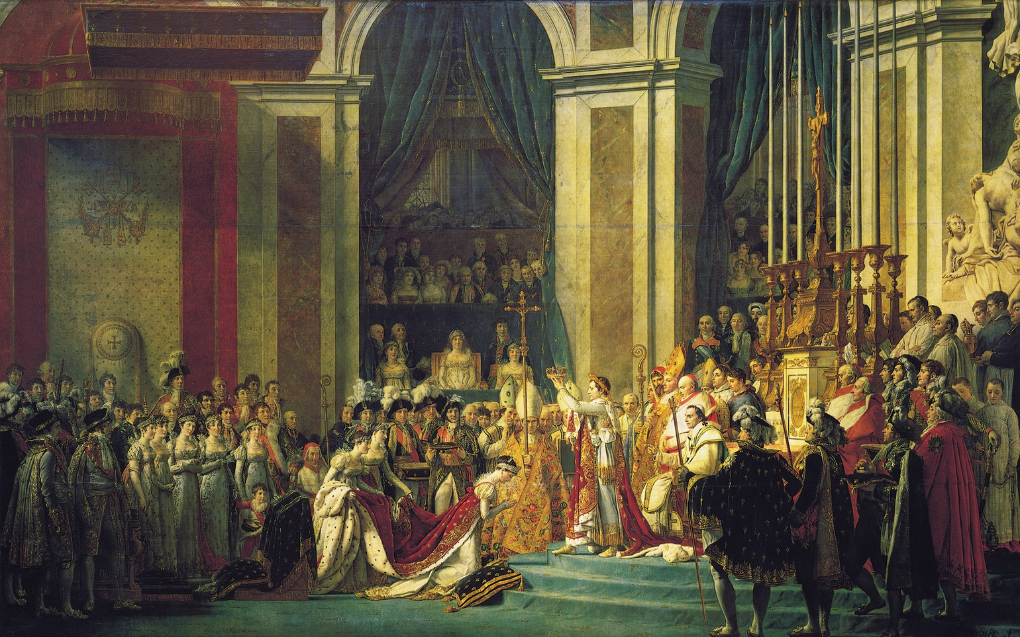
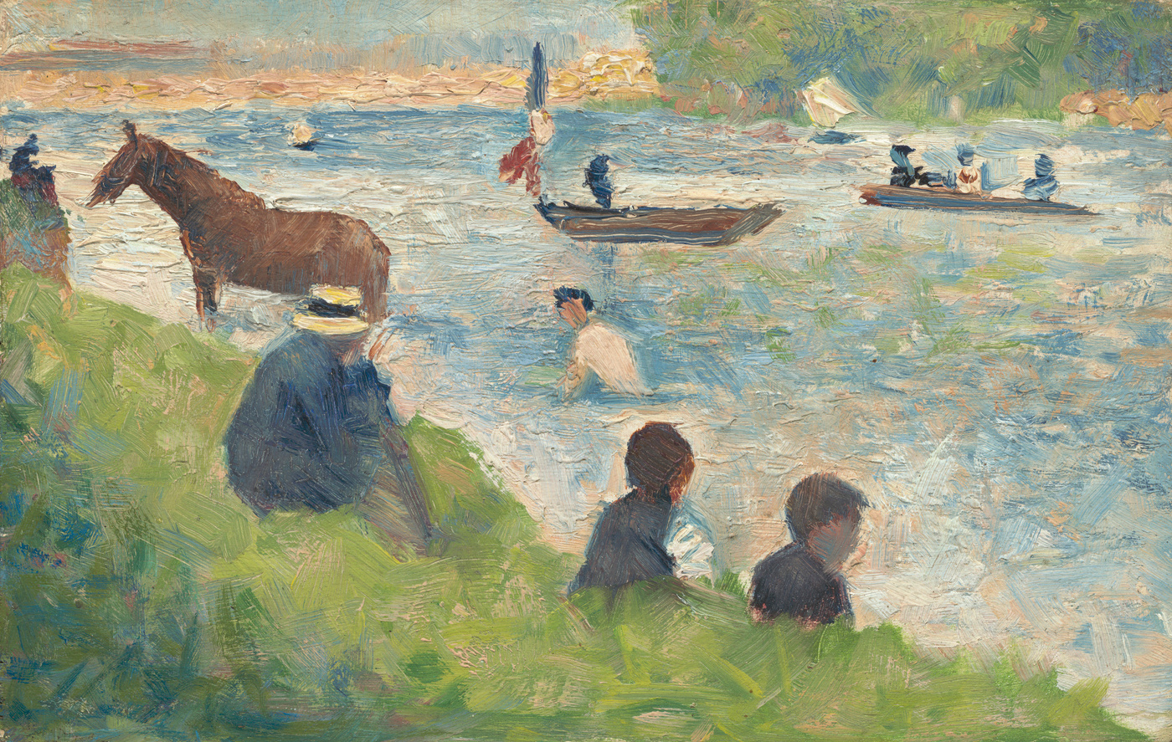
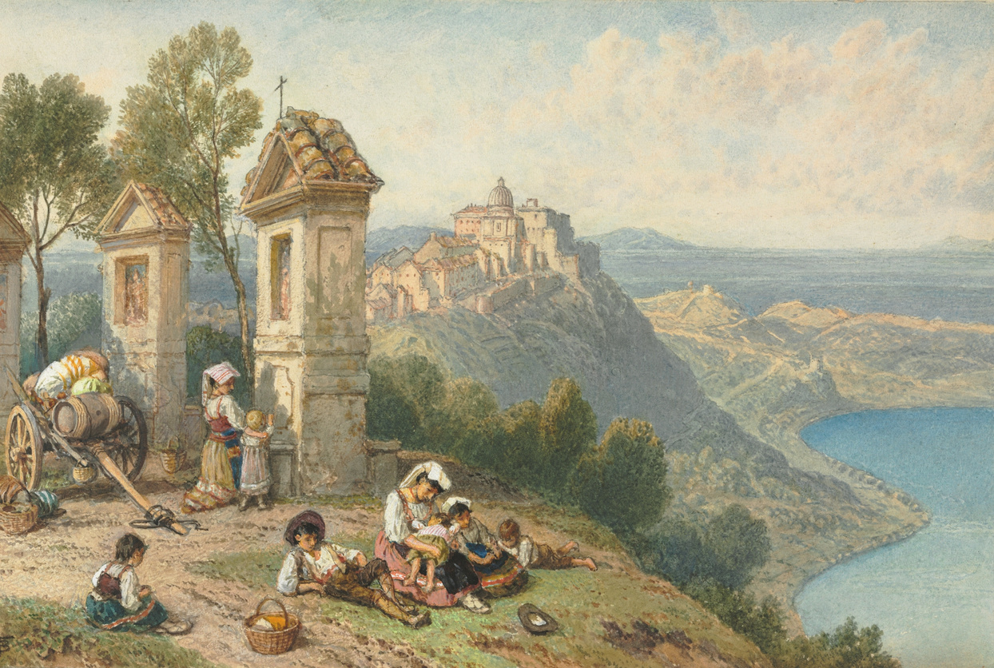
Thank You!

